Slide 1

Continuous Glucose monitoring system using FTIR spectroscopy
R.M.K. Engineering College
Team Members:
ALWIN A

Slide 2
Problem statement:
One of the most increasing cases of health-related problem in India is diabetes. Checking the glucose-level often required finger-pricking method for glucose monitoring which is painful, inconvenient, and increases the risk of infection with repeated use. Many individuals, especially those requiring frequent monitoring, find it uncomfortable and difficult to adhere to. While non-invasive alternatives exist, they are often expensive and suffer from accuracy issues due to signal noise and interference. The challenge lies in developing a reliable method that eliminates the need for invasive sampling while ensuring precise glucose measurement.

Slide 3
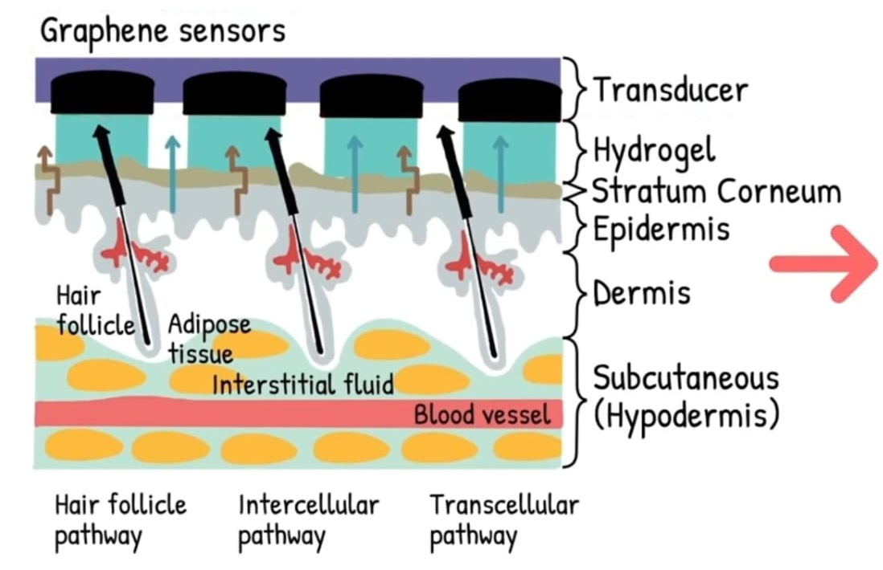
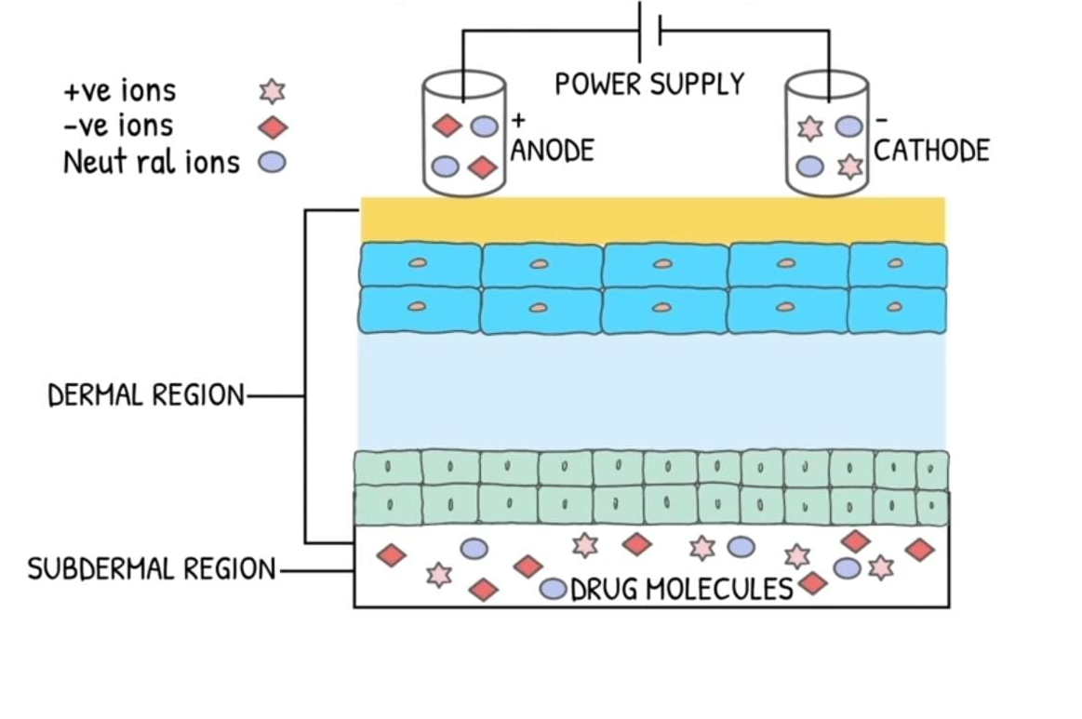
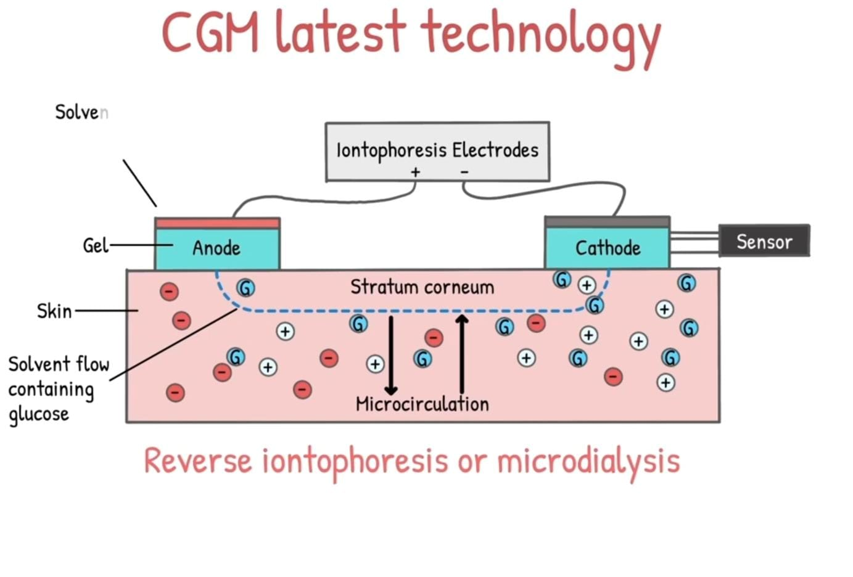
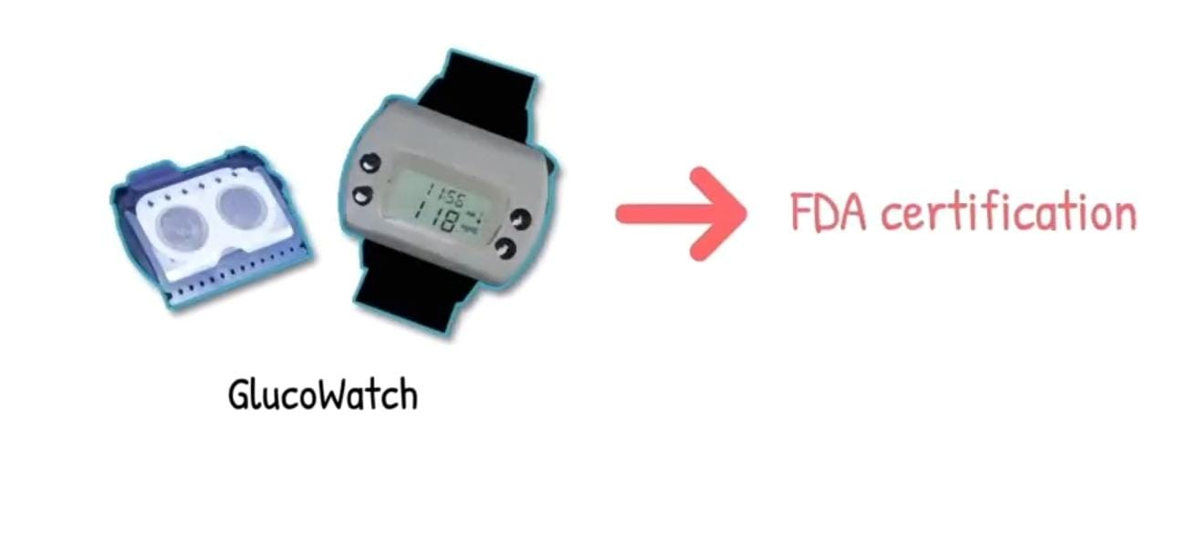
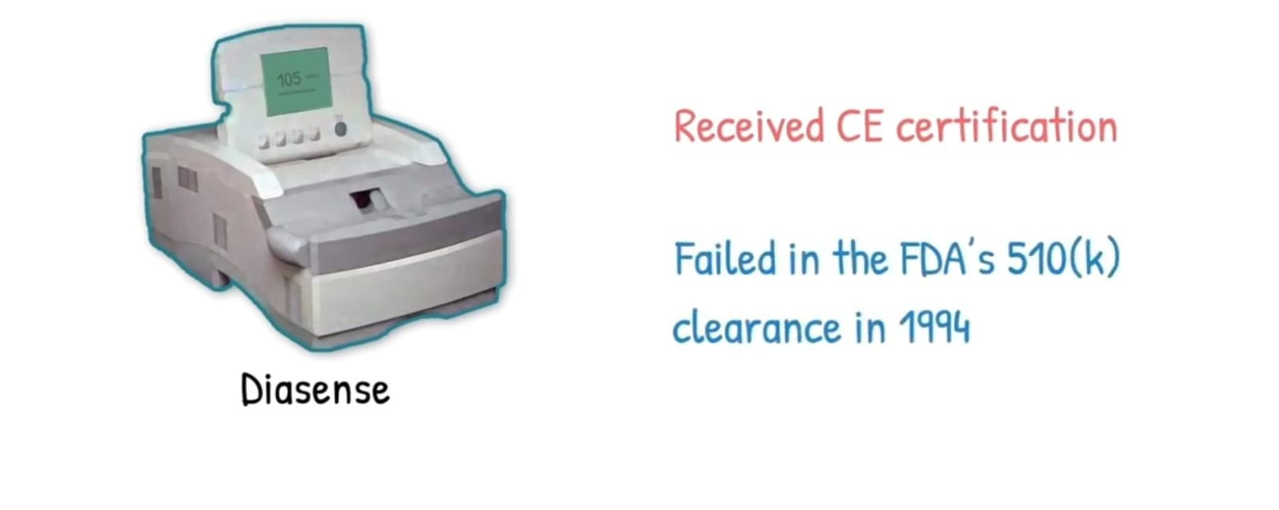
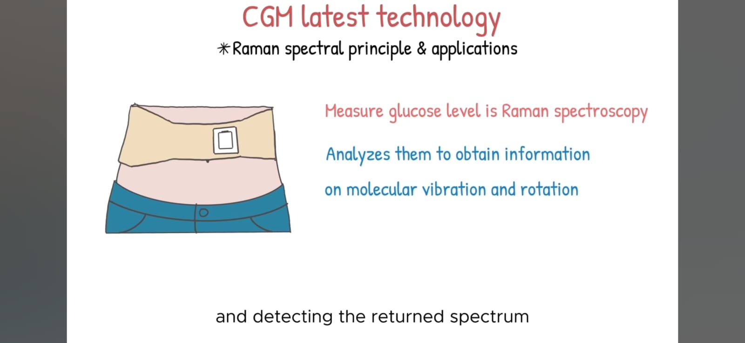
Existing Solution :
Techinques :
Products :
Microdialysis :
Graphene sensors

Slide 4
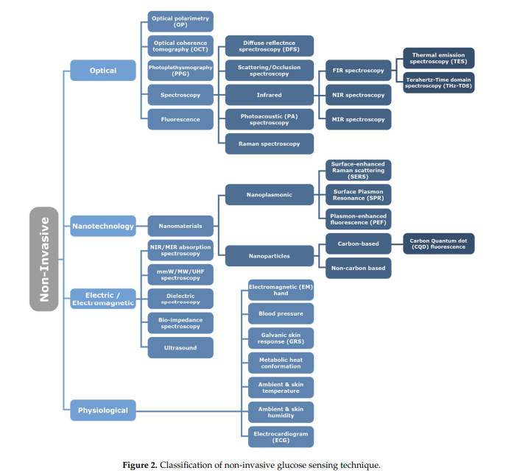
Existing Solution :
Review paper :

Slide 5
The Beer-Lambert Law describes how the intensity of light decreases as it passes through an absorbing medium. It is mathematically expressed as:
where A is the absorbance,
ε is the molar absorptivity (L/mol·cm),
c is the concentration of the absorbing species (mol/L),
l is the optical path length (cm).
This law is fundamental in quantitative spectroscopy, as it allows for the determination of molecular concentrations in solutions based on their light absorption. However, real-world applications often require corrections for scattering, fluorescence, and other interferences.

Slide 6
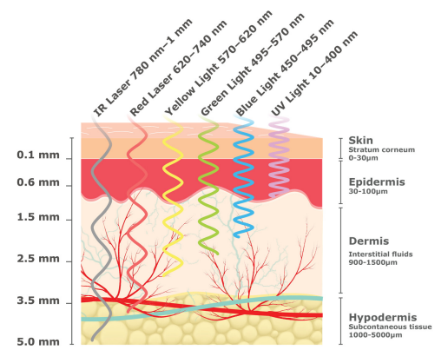
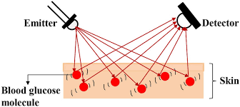
valuable information on glucose distribution, although their accuracy can be impacted by the various substances encountered within the various skin layers

Slide 7
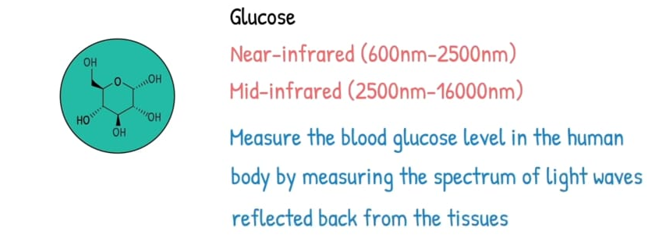
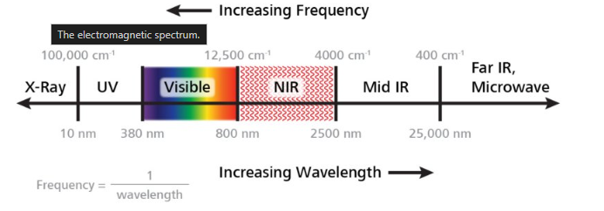
Near-Infrared (NIR) Spectroscopy
NIR spectroscopy utilizes the wavelength range of 710 nm to 2500 nm, making it particularly useful for non-invasive glucose detection. Unlike UV-Vis spectroscopy, which relies on electronic transitions, NIR spectroscopy measures overtones and combinations of vibrational modes of molecules. The absorption bands in this region are weaker, enabling deeper penetration into biological tissues., offering real-time, non-destructive analysis.

Slide 9
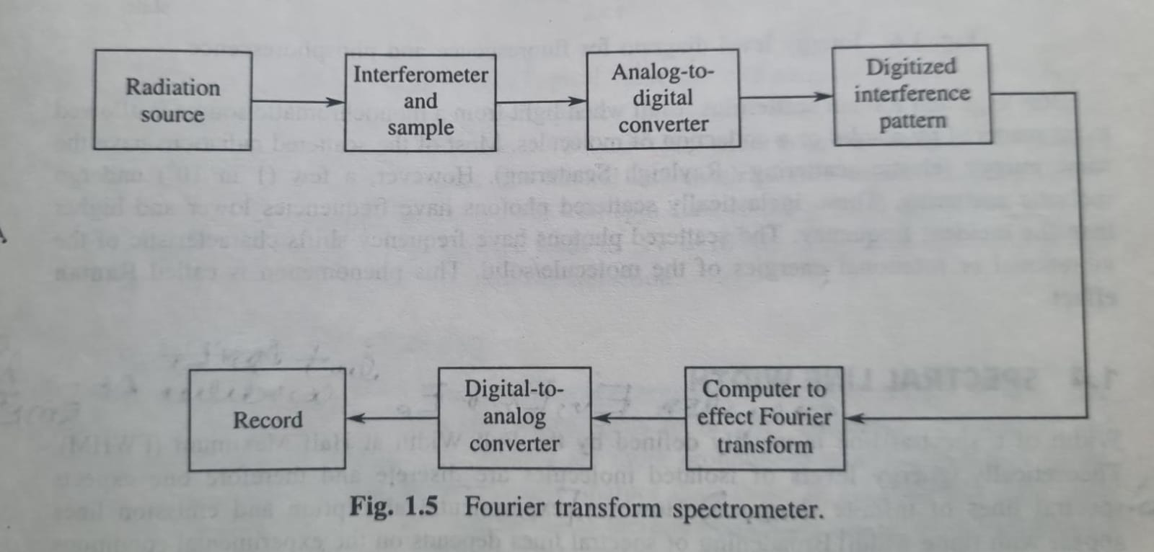

Slide 10
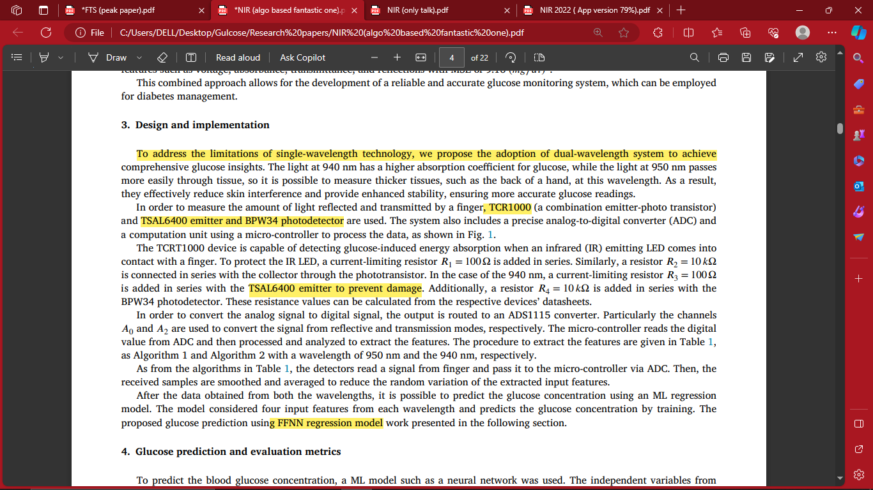
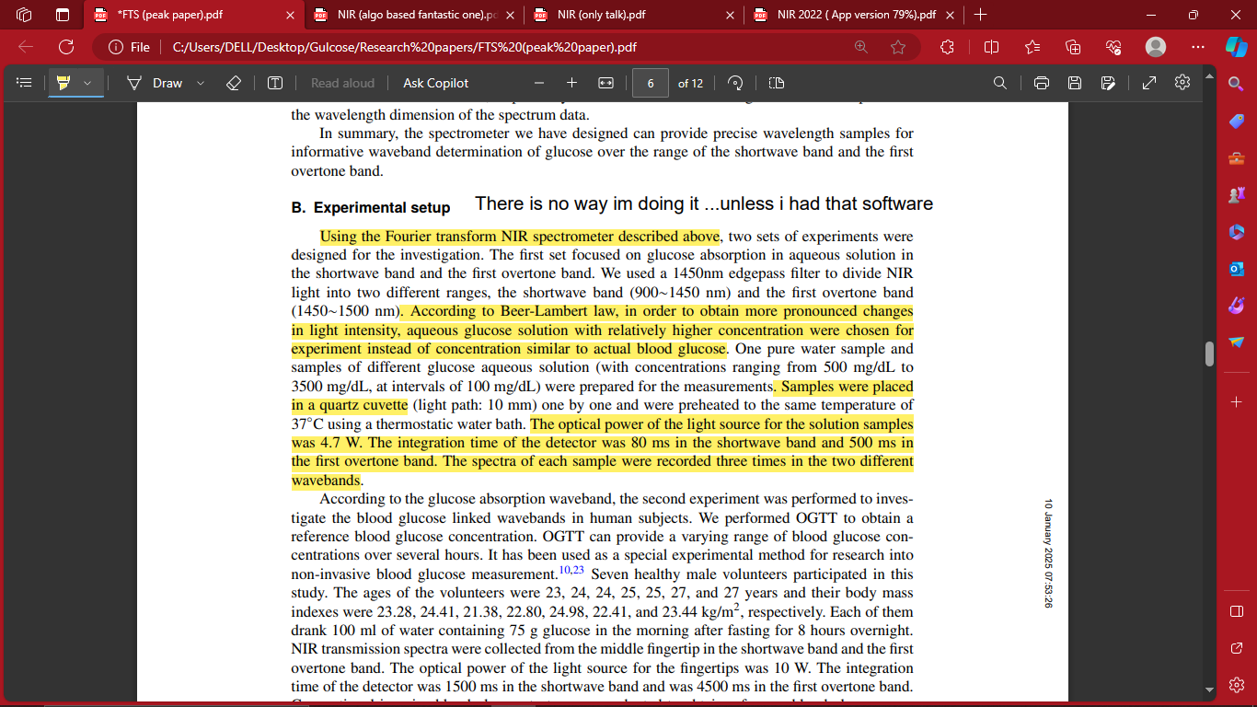
Existing Solution :
Research papers :

Slide 11
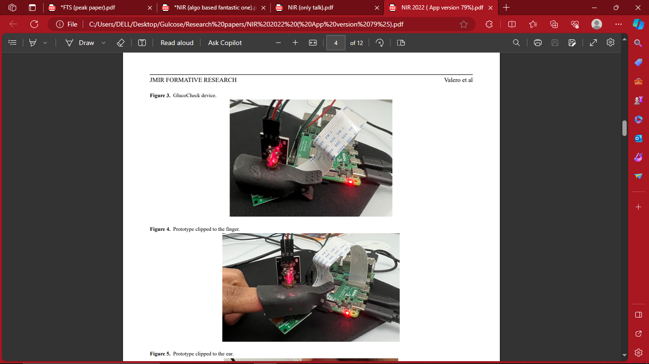
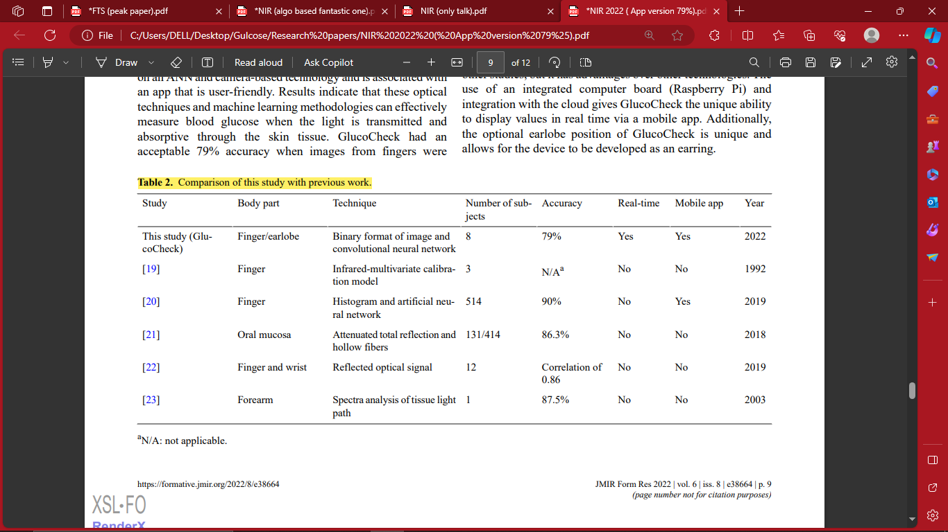
Research papers :

Slide 12
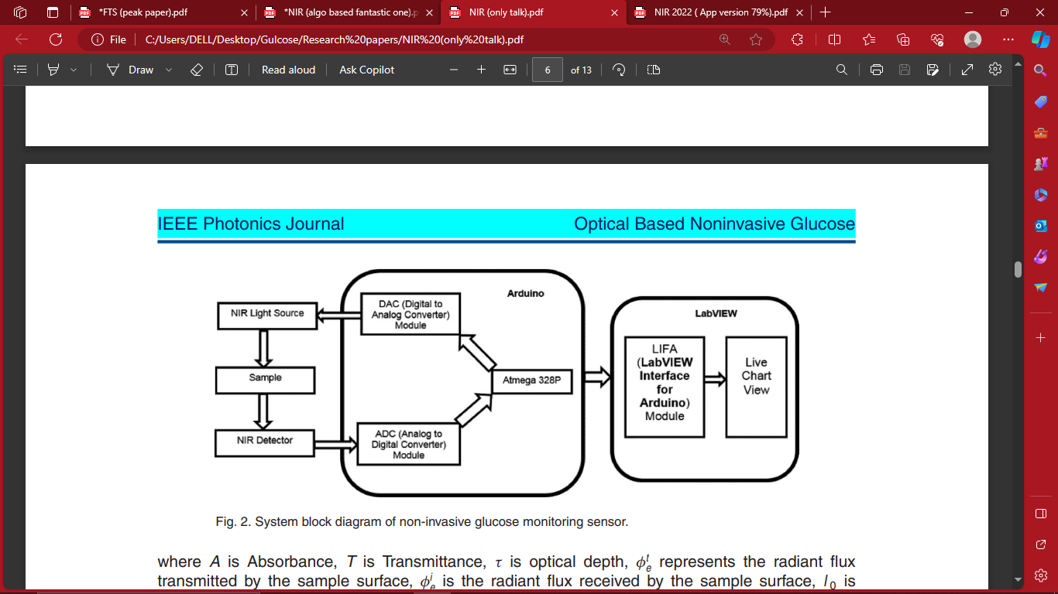
Research papers :

Slide 13
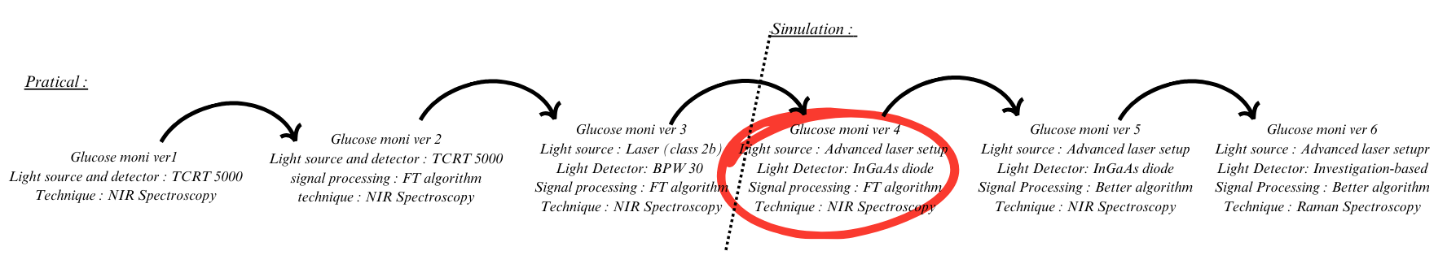
Road map :

Slide 14
My hypothetical solution :
Glucose monitoring system Ver.4 :
In this project, glucose detection is achieved using a multi-laser system and an InGaAs detector, applying Beer-Lambert's law for non-invasive measurement.
The collected data is processed through a microprocessor, where the signal is transformed into the frequency domain using Fourier Transform. To improve accuracy, noise is reduced using algorithms such as Spectral Subtraction , low pass filtering , band pass filtering. Finally, applying the Inverse Fourier Transform enables spectral analysis for precise glucose concentration estimation.

Slide 15
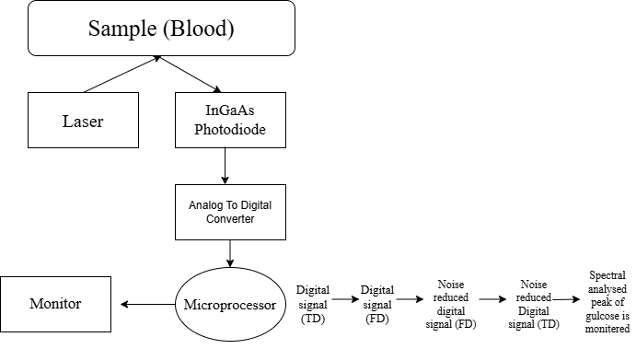
Flow chart :

Slide 16
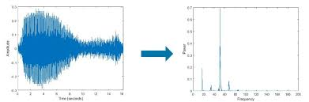
Signal processing :
Fourier Transform :
The Fourier Transform (FT) is used to convert a digitalized signal from the time domain to the frequency domain, with the Fast Fourier Transform (FFT) being employed for computational efficiency, offering superior performance over the traditional Discrete Fourier Transform (DFT).

Slide 17
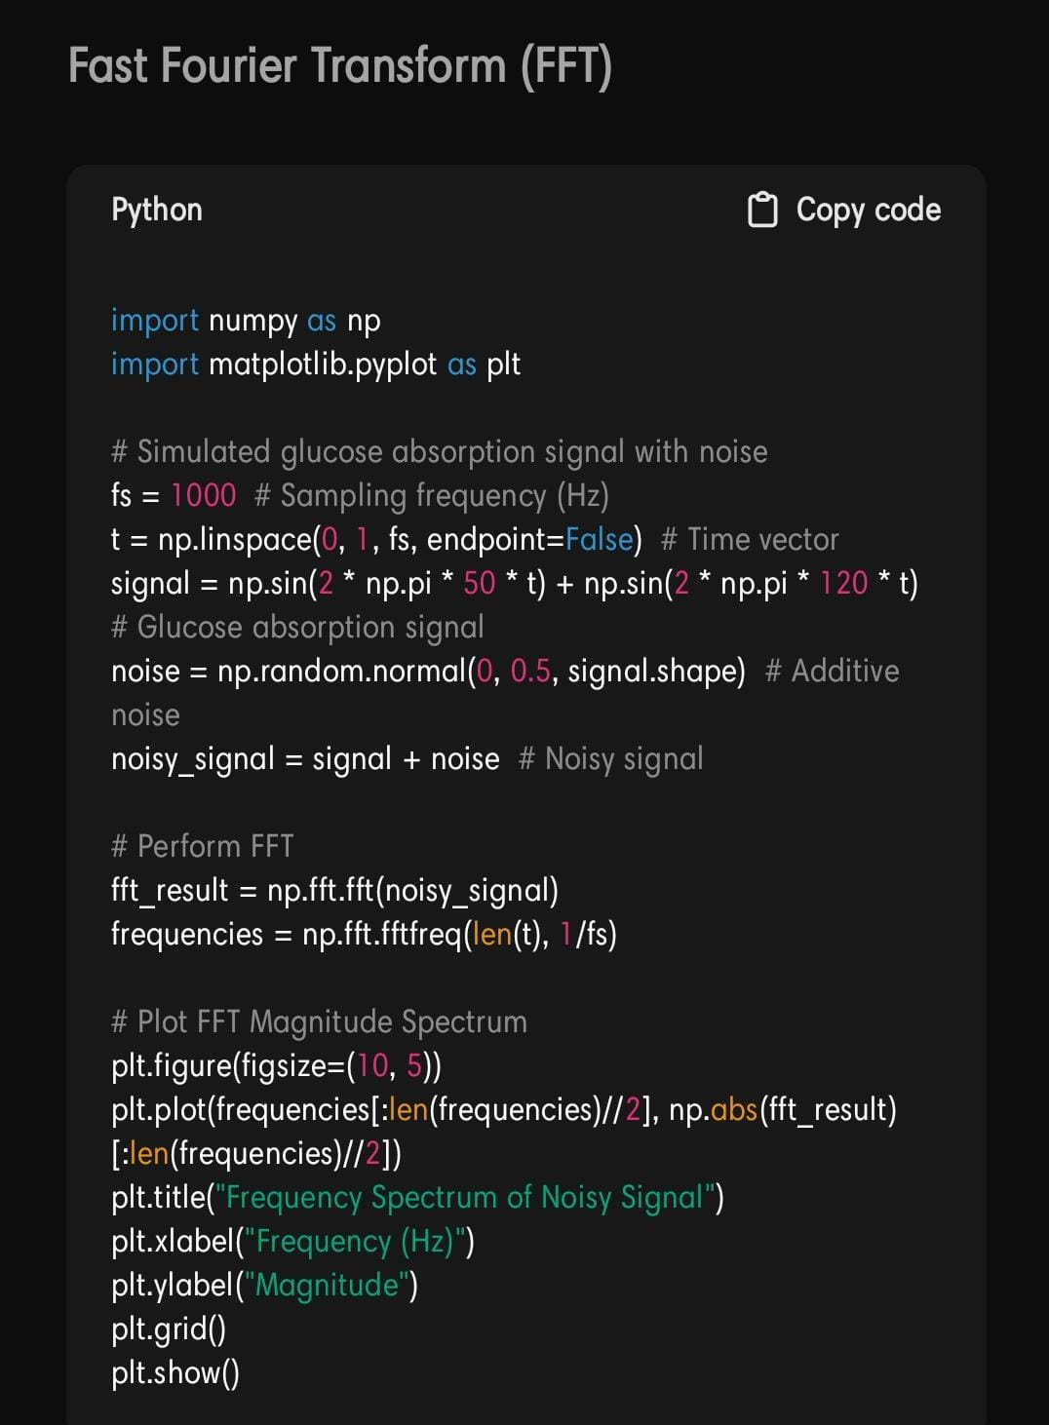
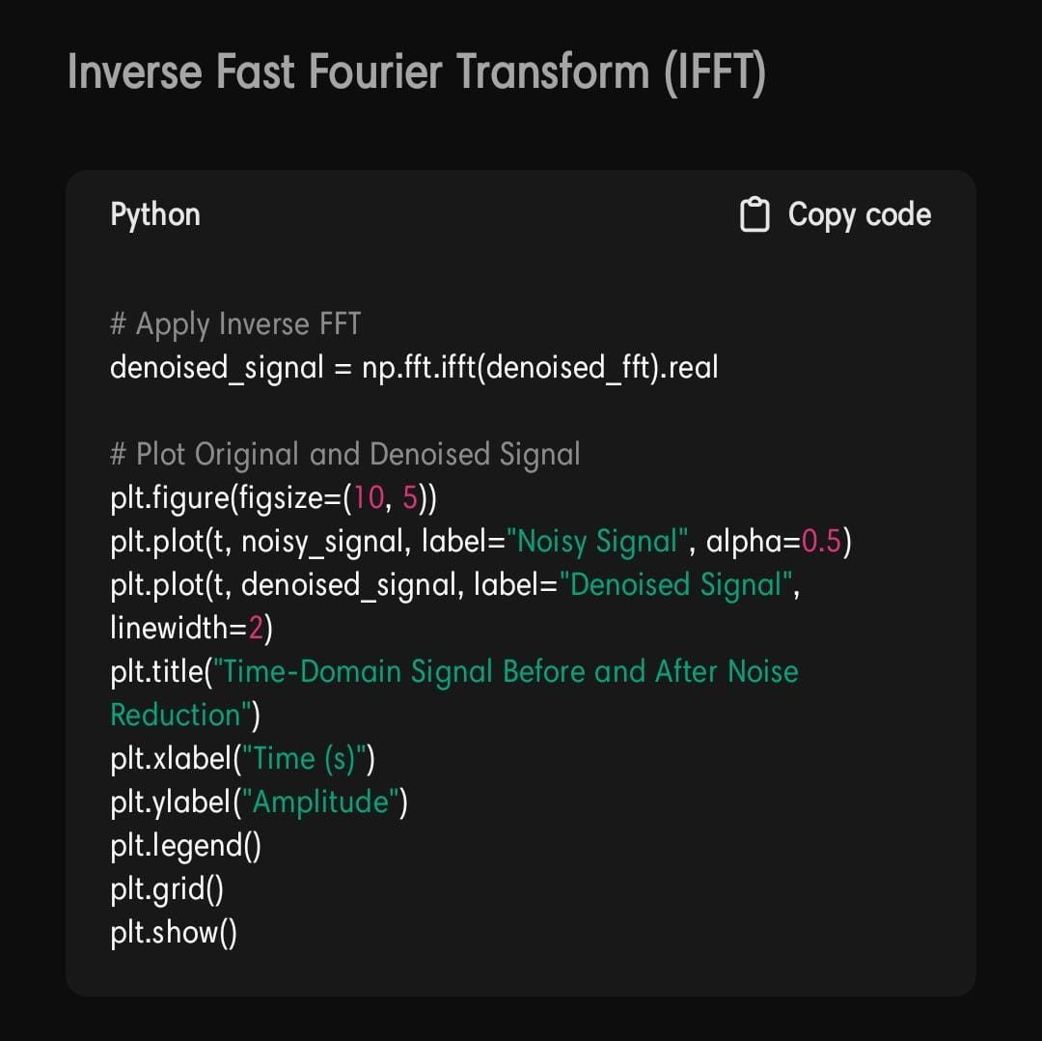
Signal processing :
Fourier Transform :

Slide 18
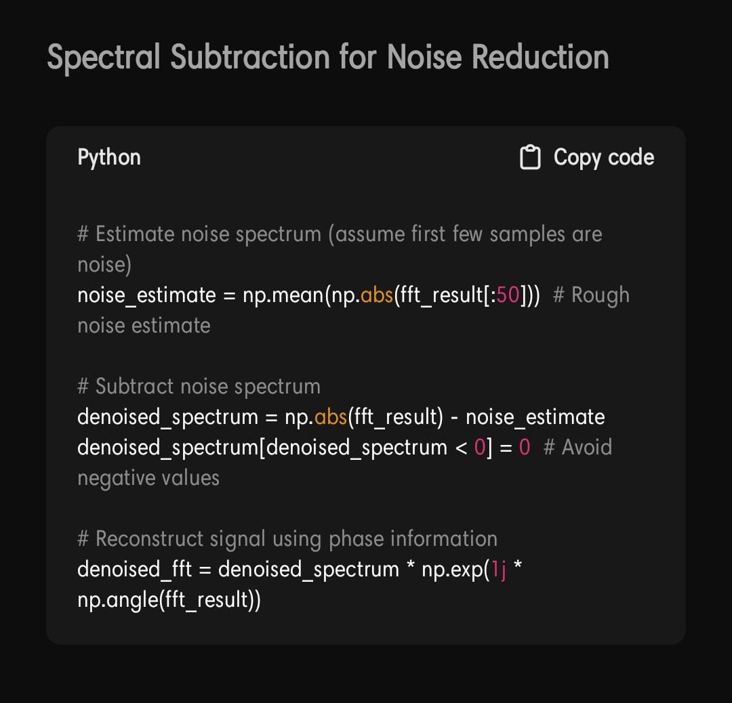
Noise reduction :
After transforming the signal from
the time domain to the frequency do
main, spectral subtraction is applied
as a noise reduction technique .This
method involves estimating the noise
spectrum and subtracting it from the
noisy signal’s spectrum. By doing so
, it effectively reduces unwanted noise
while preserving the signal's underlying
structure. Spectral subtraction is
particularly effective in scenarios where
the noise characteristics are relatively
stationary, allowing for clear signal
enhancement and improved signal quality.

Slide 19
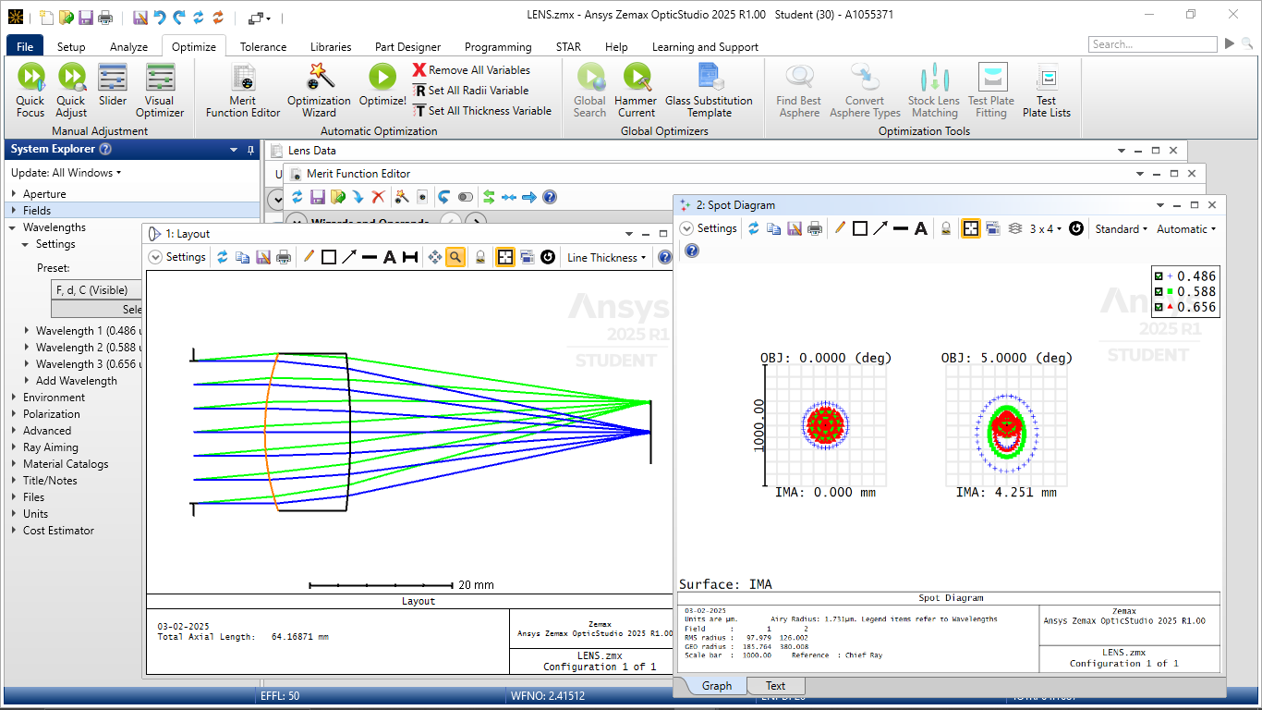
Simulation :
Zemax OpticStudio is a powerful optical design software used to model and analyze optical systems. It allows you to create lasers by defining properties such as wavelength, beam size, and divergence, making it possible to simulate laser sources in your optical setup. For lens design, you can specify various parameters like material properties, curvature, and thickness to create and optimize lenses such as spherical or aspheric types. The software also provides ray tracing simulations to visualize how light behaves through the system, ensuring efficient design and performance optimization before physical implementation

Slide 20
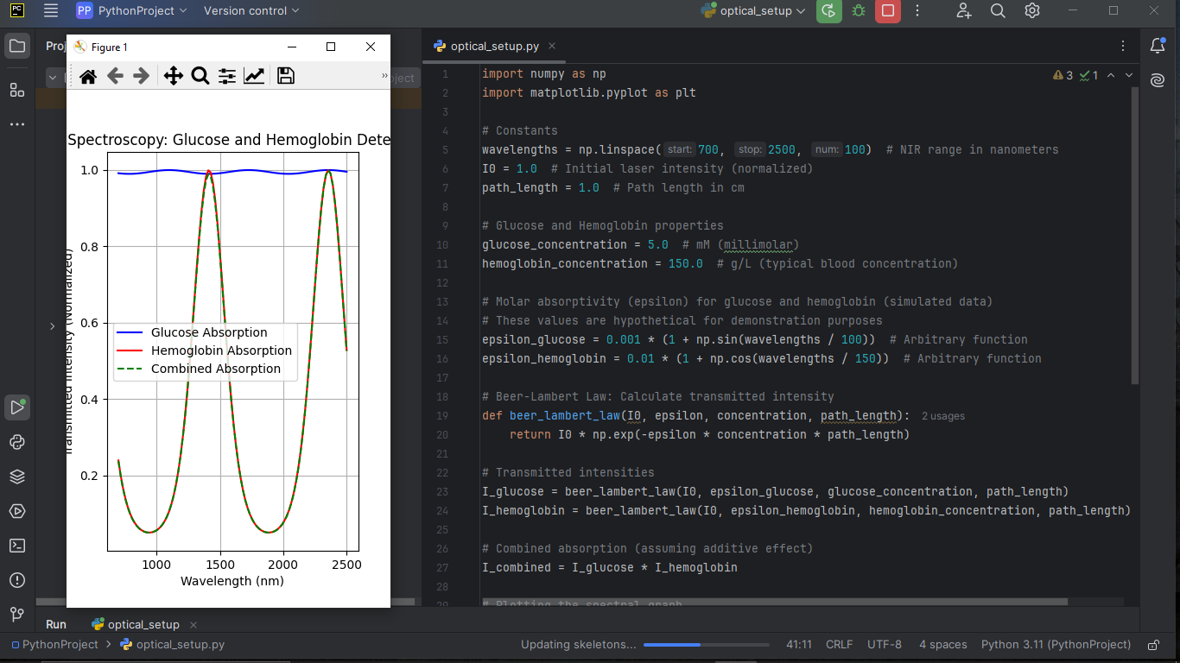
Simulation :

Slide 21
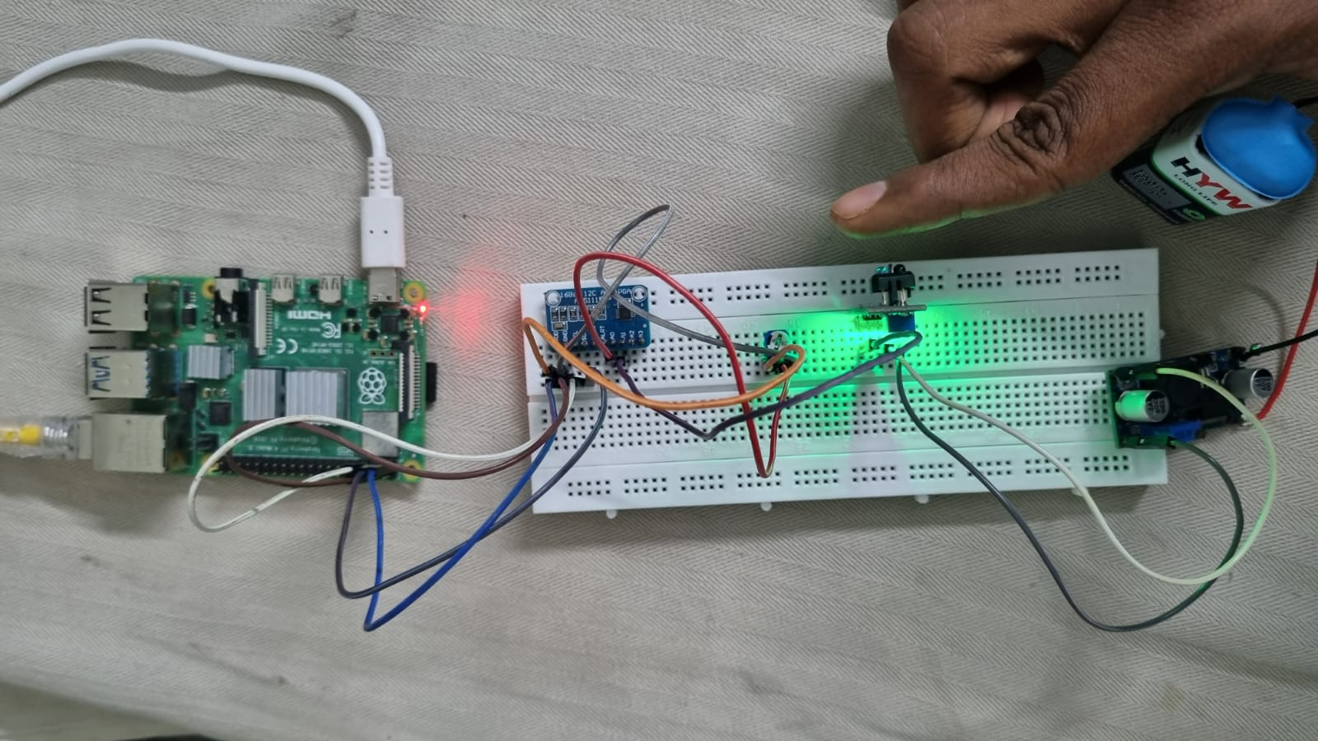
On working : Glucose ver 1.,

Slide 22
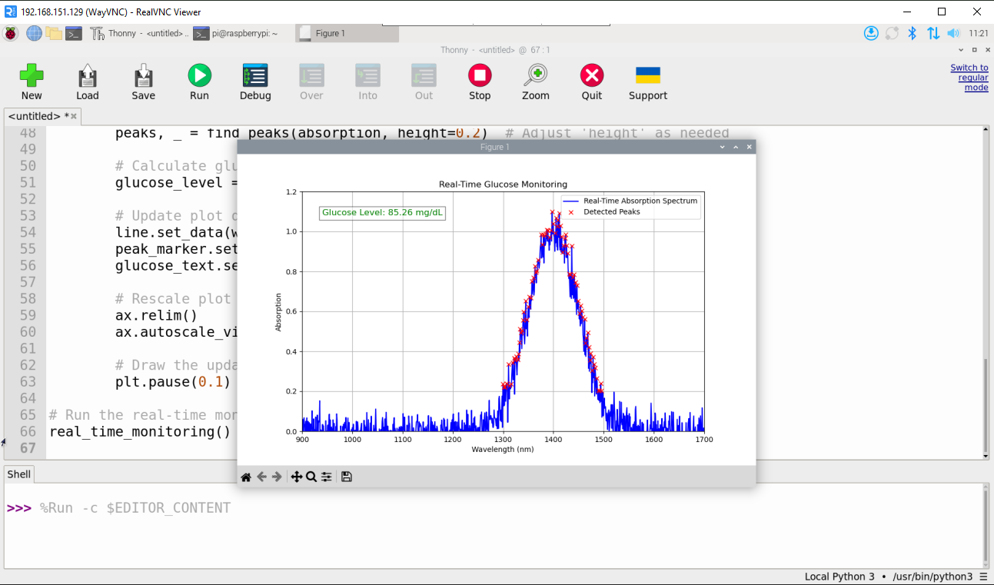

Slide 23
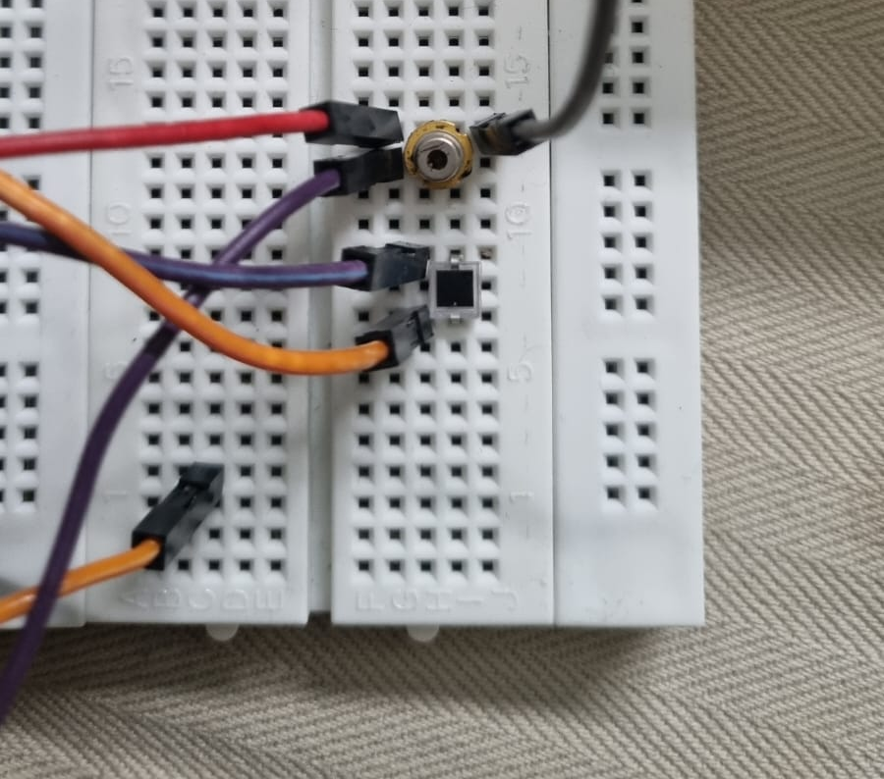
On Working : Glucose Ver 3.,

Slide 24
Thankyou !!

